Slide 1
Support Vector Machine

Slide 2
A Few Terminology
Hyperplane
Margin
Misclassification
Low dimension to high dimension
Kernel

Slide 3
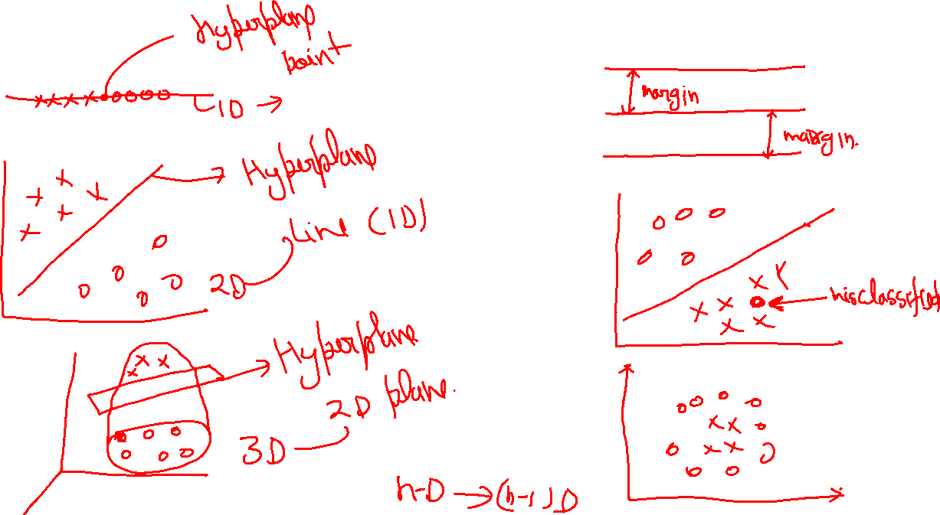

Slide 4
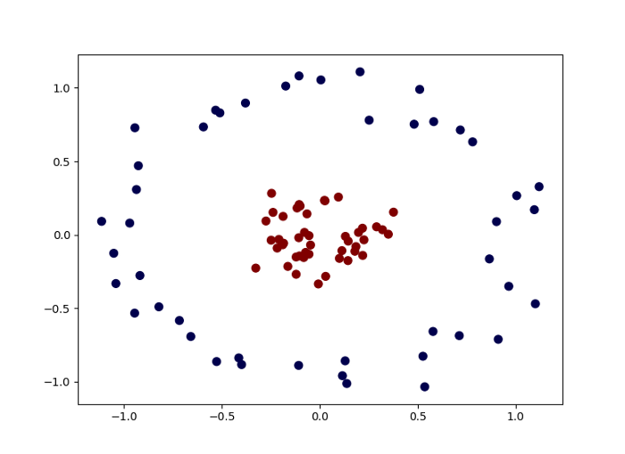
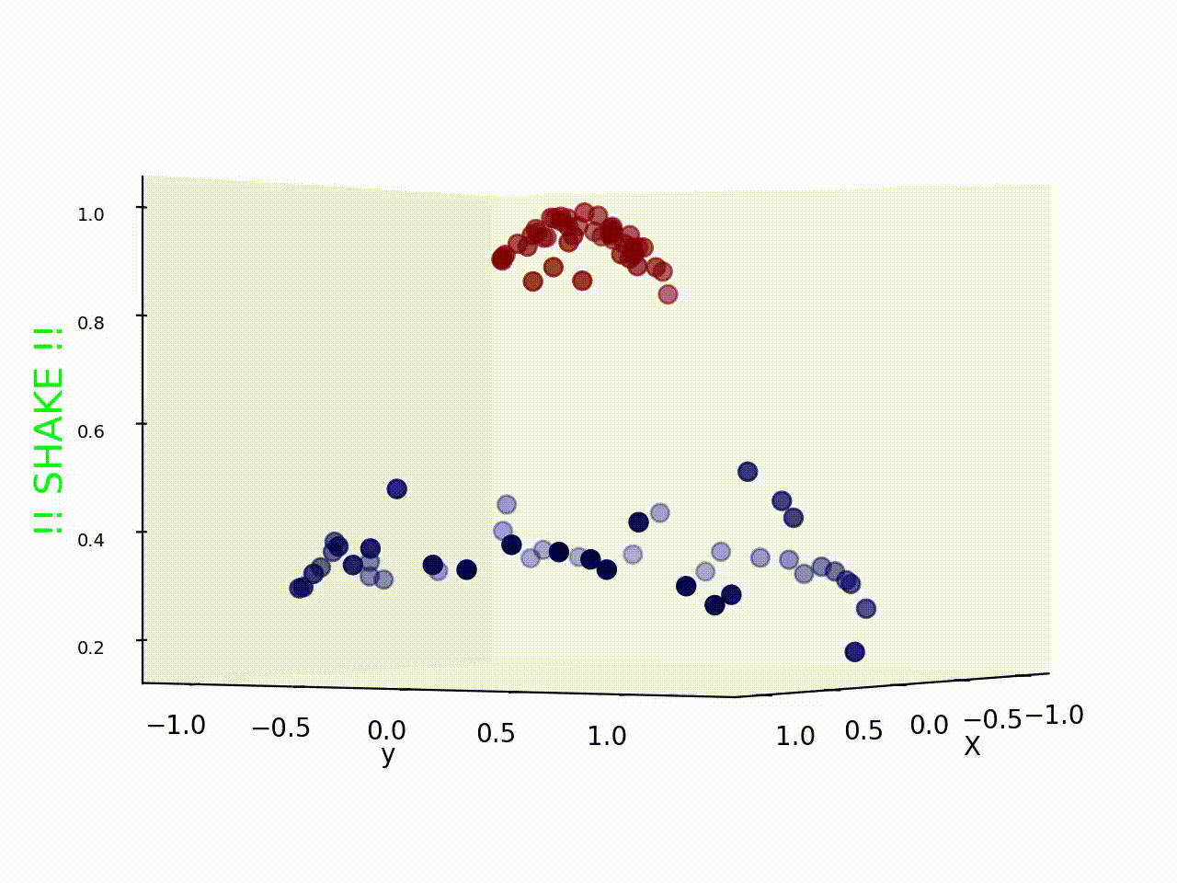
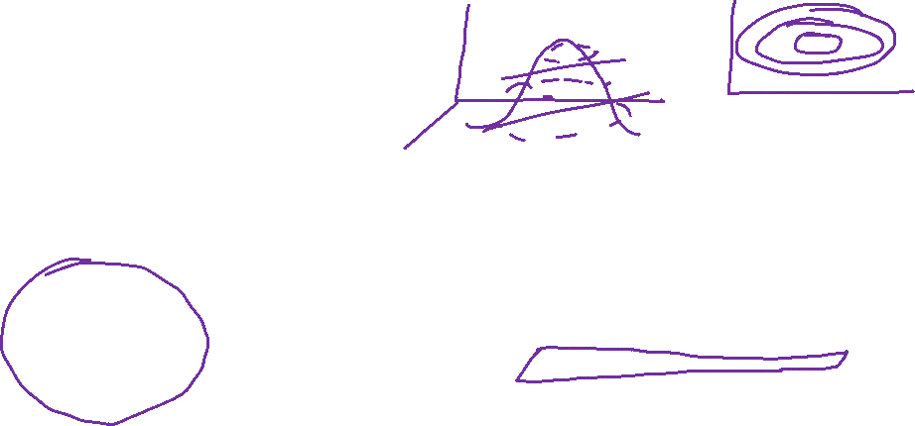
Low to High dimension

Slide 5
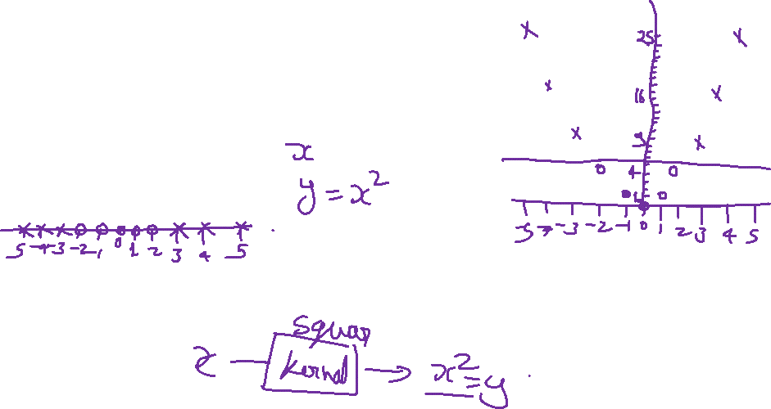
Lets take an Example

Slide 6
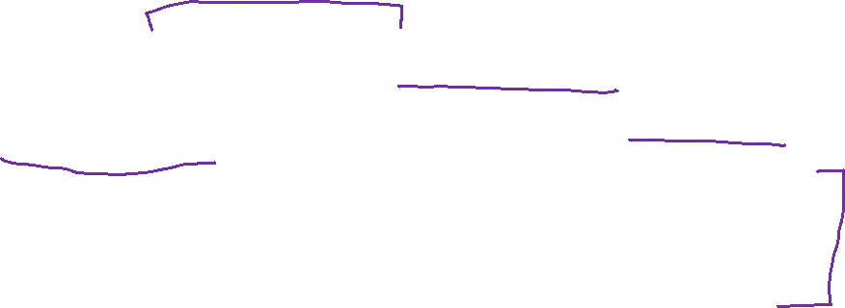
Support vector Machine
Three main ideas:
Define what an optimal hyperplane is (taking into account that it needs to be computed efficiently): maximize margin
Generalize to non-linearly separable problems: have a penalty term for misclassifications
Map data to high dimensional space where it is easier to classify with linear decision surfaces: reformulate problem so that data are mapped implicitly to this space

Slide 7
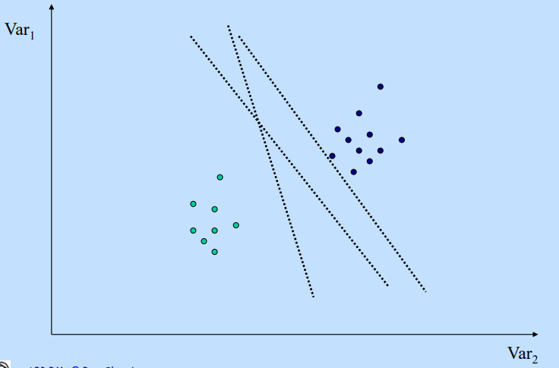
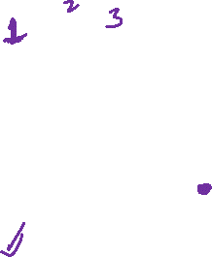
Optimal hyperplane

Slide 8
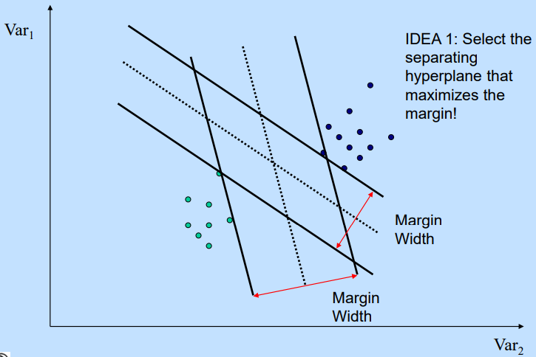
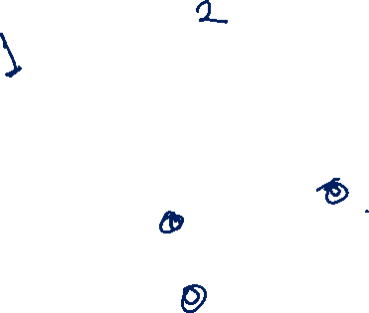
Maximizing the Margin

Slide 9
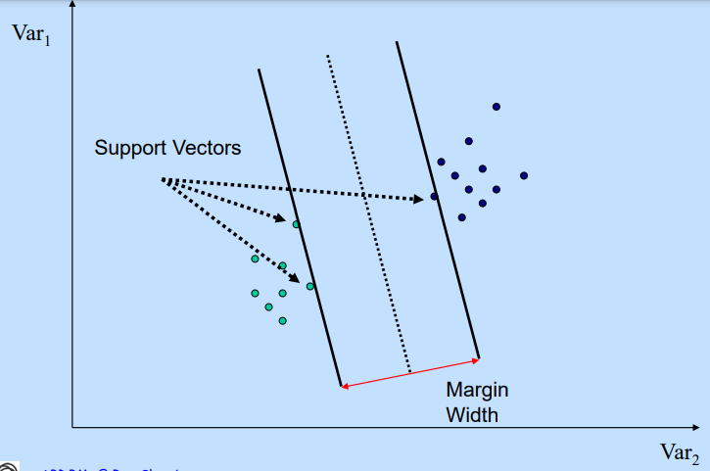
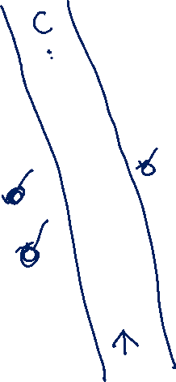
Support Vectors

Slide 10
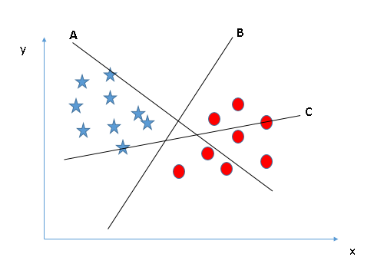

Identify the right hyperplane (Scenario-1):
Here, we have three hyperplanes (A, B and C). Now, identify the right hyperplane to classify star and circle.

Slide 11
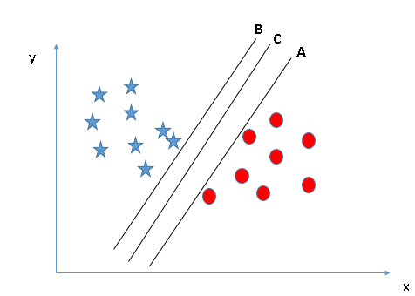
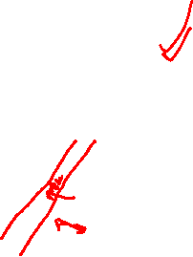
Identify the right hyperplane (Scenario-2):
Here, we have three hyperplanes (A, B and C) and all are segregating the classes well. Now, how can we identify the right hyperplane?
Here, maximizing the distances between nearest data point (either class) and hyperplane will help us to decide the right hyperplane.

Slide 12
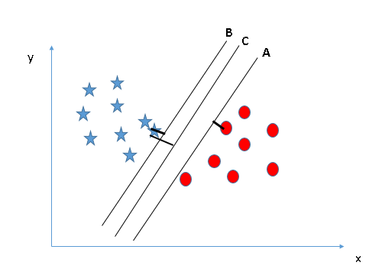
Scenario-2
This distance is called as Margin. Let’s look at the below snapshot:
We can see that the margin for hyperplane C is high as compared to both A and B. Hence, we name the right hyperplane as C. Another lightning reason for selecting the hyperplane with higher margin is robustness. If we select a hyperplane having low margin then there is high chance of missclassification.

Slide 13
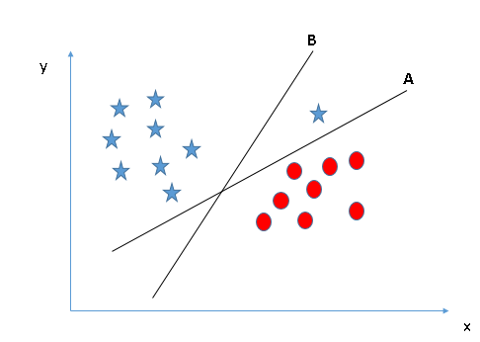
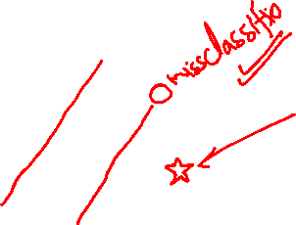
Identify the right hyperplane (Scenario-3)
Some of you may have selected the hyper-plane B as it has higher margin compared to A. But, here is the catch, SVM selects the hyperplane which classifies the classes accurately prior to maximizing margin. Here, hyperplane B has a classification error and A has classified all correctly. Therefore, the right hyperplane is A.

Slide 14
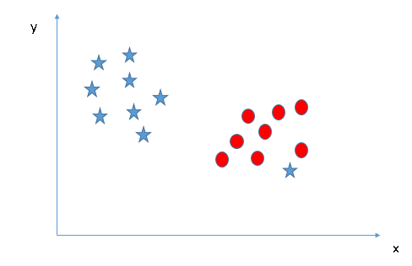
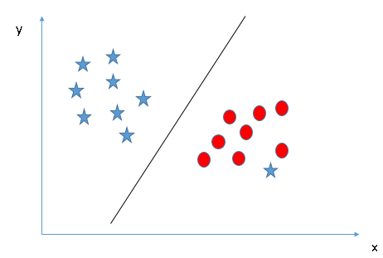
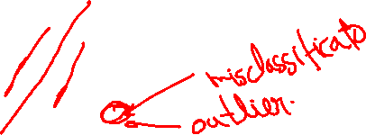
Can we classify two classes (Scenario-4)?
We are unable to segregate the two classes using a straight line, as one of star lies in the territory of other (circle) class as an outlier.
One star at other end is like an outlier for star class. SVM has a feature to ignore outliers and find the hyperplane that has maximum margin. Hence, we can say, SVM is robust to outliers.

Slide 15
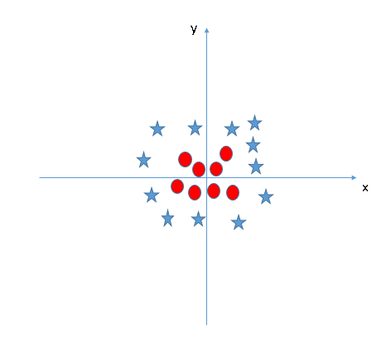
Find the hyperplane to segregate to classes (Scenario-5)
In the scenario below, we can’t have linear hyperplane between the two classes, so how does SVM classify these two classes? Till now, we have only looked at the linear hyperplane.
SVM can solve this problem. It solves this problem by introducing additional feature. Here, we will add a new feature z=x²+y².

Slide 16
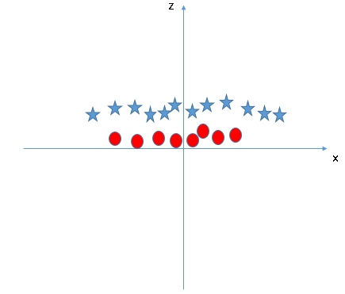
Scenario-5
Now, let’s plot the data points on axis x and z:
In above plot, points to consider are:
All values for z would be positive always because z is the squared sum of both x and y
In the original plot, red circles appear close to the origin of x and y axes, leading to lower value of z and star relatively away from the origin result to higher value of z.

Slide 17
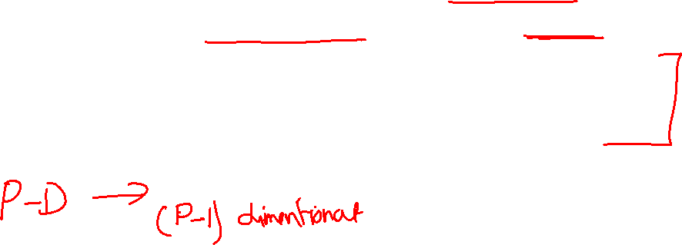
Linear Separating Hyperplanes
This linear separating plane need not pass through the origin of our feature space, i.e. it does not need to include the zero vector as an entity within the plane. Such hyperplanes are known as affine.
If we consider a real-valued p-dimensional feature space, known mathematically as ℜ^{p}, then our linear separating hyperplane is an affine p−1 dimensional space embedded within it.

Slide 18
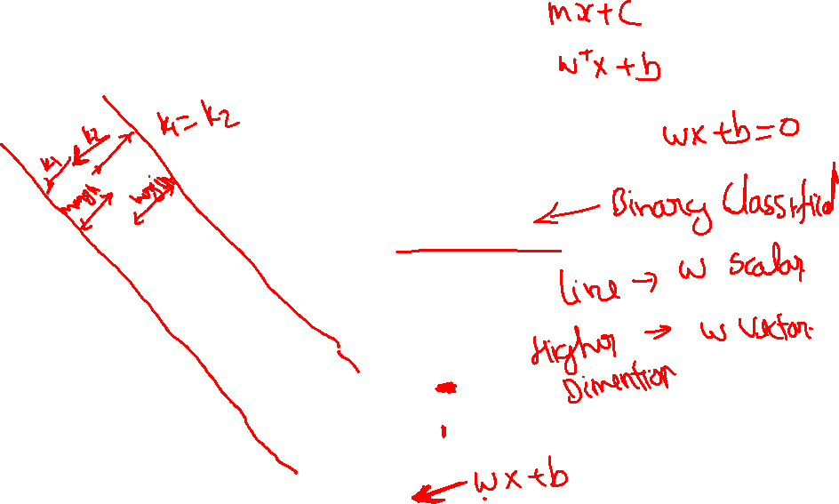
Linear Support Vector Machines
Data: <x_{i},y_{i}>, i=1,..,l
x_{i} ∈ R^{d}
y_{i} ∈ {-1,+1}
x2
=+1
=-1
x1

Slide 19
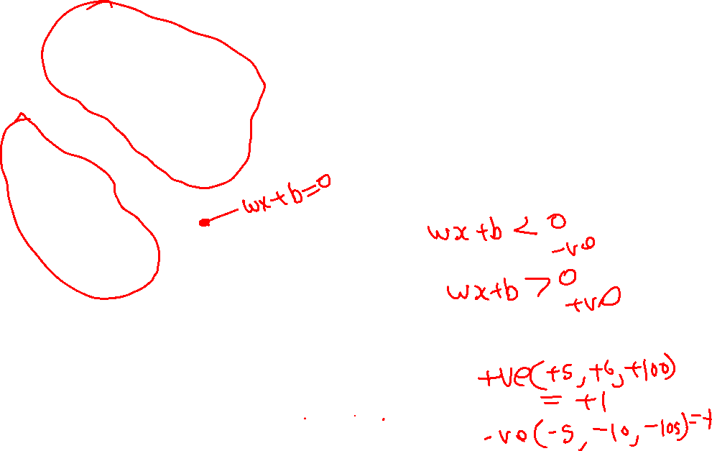
Linear SVM
Data: <x_{i},y_{i}>, i=1,..,l
x_{i} ∈ R^{d}
y_{i} ∈ {-1,+1}
f(x)
=-1
=+1
All hyperplanes in R^{d} are parameterize by a vector (w) and a constant b.
Can be expressed as w•x+b=0 (remember the equation for a hyperplane
from algebra!)
Our aim is to find such a hyperplane f(x)=sign(w•x+b), that
correctly classify our data.

Slide 20
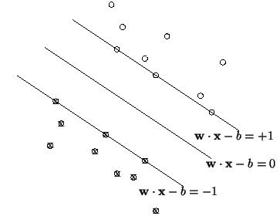
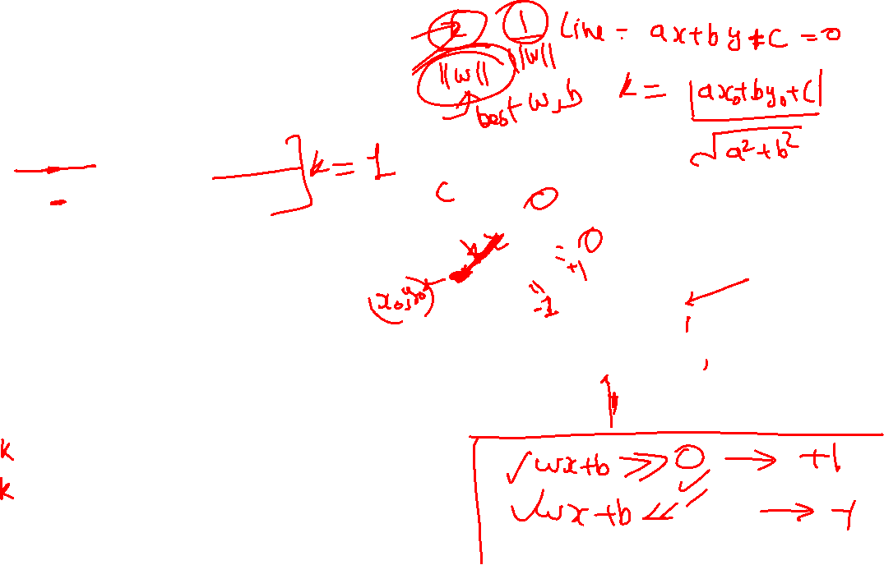
Definitions
Define the hyperplane H such that:
x_{i}•w+b ≥ +1 when y_{i} =+1
x_{i}•w+b ≤ -1 when y_{i} =-1
H1
H1 and H2 are the planes:
H1: x_{i}•w+b = +1
H2: x_{i}•w+b = -1
The points on the planes H1 and H2 are the Support Vectors
H2
^{k+}
^{k-}
H
d+ = the shortest distance to the closest positive point
d- = the shortest distance to the closest negative point
The margin of a separating hyperplane is k⁺ + k⁻.

Slide 21
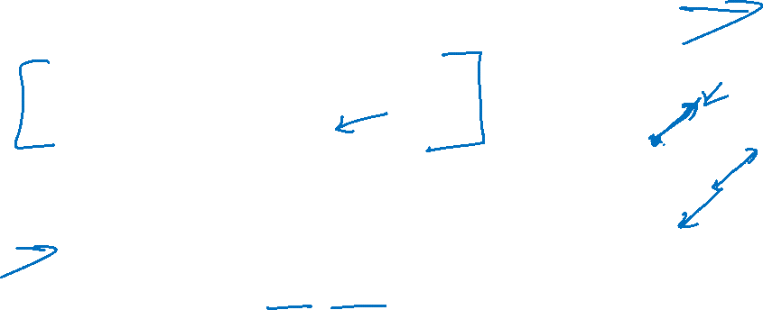
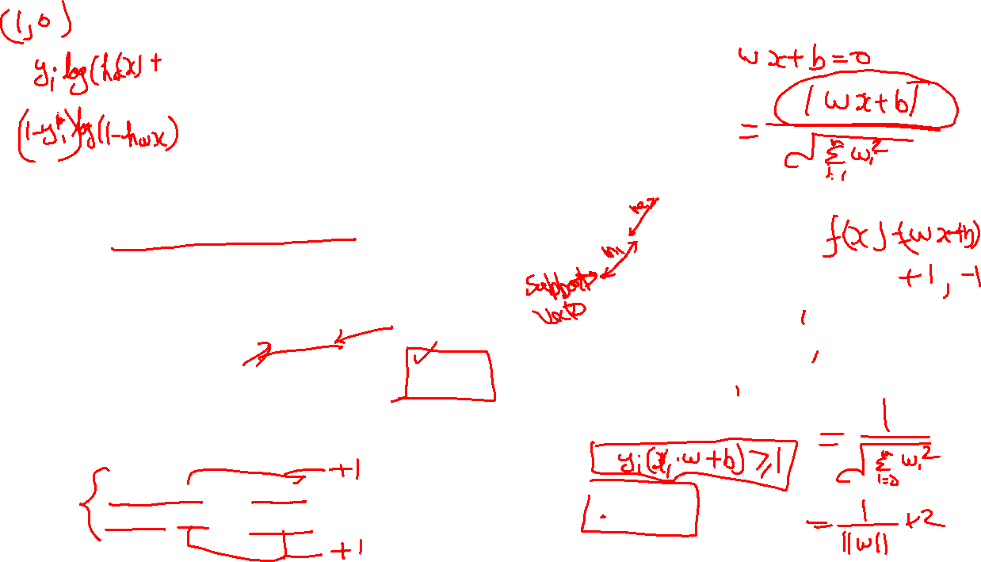
Maximizing the margin
We want a classifier with as big margin as possible.
H1
Recall the distance from a point(x₀,y₀) to a line:
Ax+By+c = 0
is|A x₀ +B y₀ +c|/sqrt(A²+B²)
H
H2
k+
k-
The distance between H and H1 is:
|w•x+b|/||w||=1/||w||
The distance between H1 and H2 is: 2/||w||
In order to maximize the margin, we need to minimize ||w||. With the
condition that there are no datapoints between H1 and H2:
x_{i}•w+b ≥ +1 when y_{i} =+1
x_{i}•w+b ≤ -1 when y_{i} =-1 Can be combined into yi(x_{i}•w) ≥ 1

Slide 22
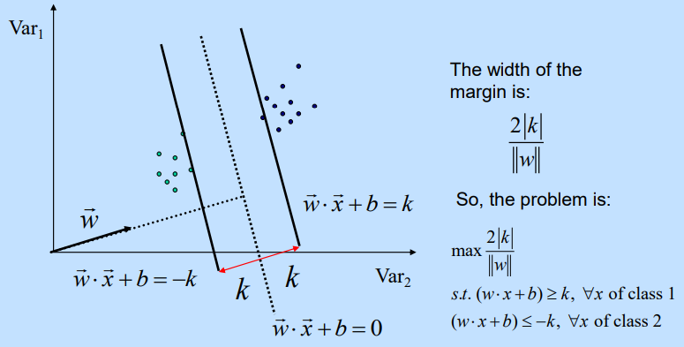
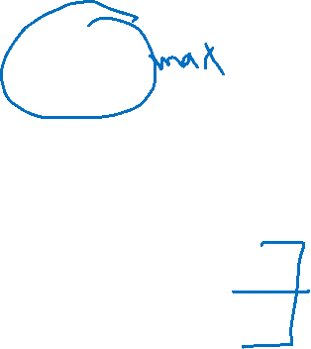
Setting Up the Optimization Problem

Slide 23
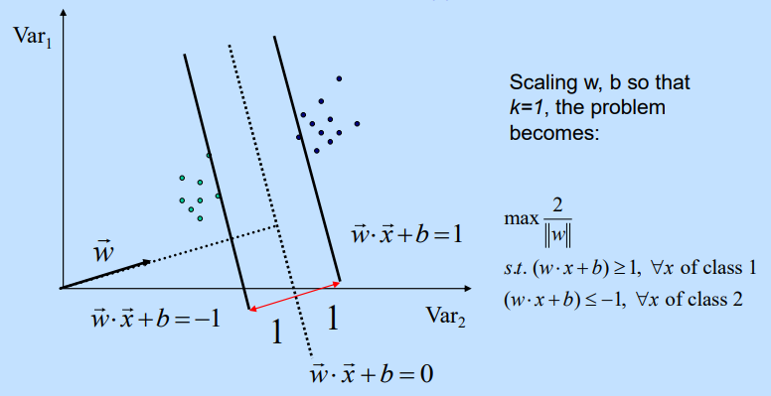

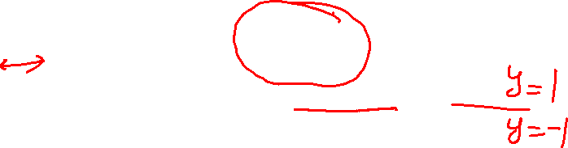
Setting Up the Optimization Problem

Slide 24
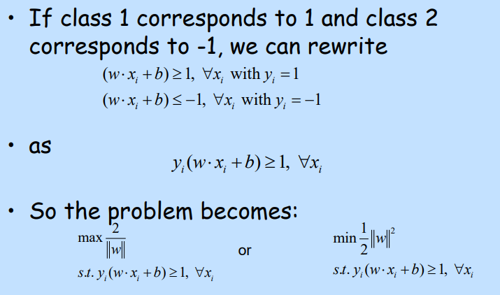
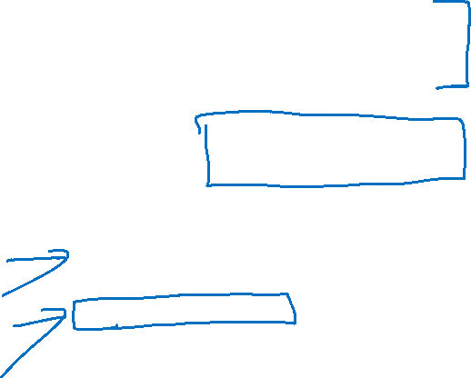
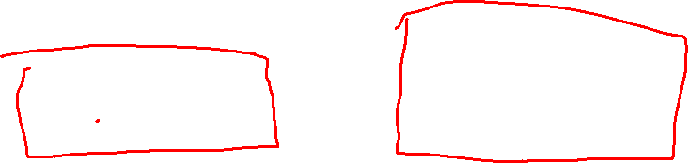
Setting Up the Optimization Problem

Slide 25
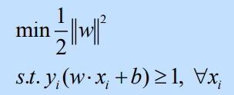
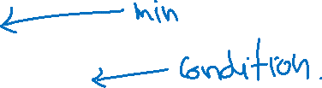
Linear, Hard-Margin SVM Formulation
Find w, b that solve
Quadratic program: quadratic objective, linear (in)equality constraints
• There is also a unique minimizer, i.e. w and b values that provide the minimum
• No solution if the data are not linearly separable

Slide 26
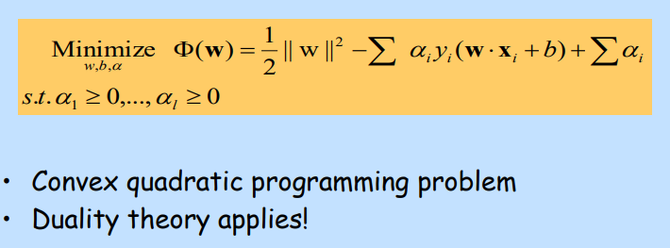
Lagrange multipliers

Slide 27
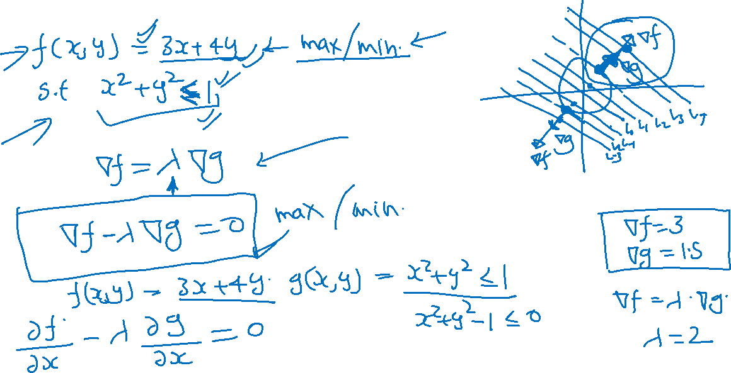
Lagrange multipliers

Slide 28
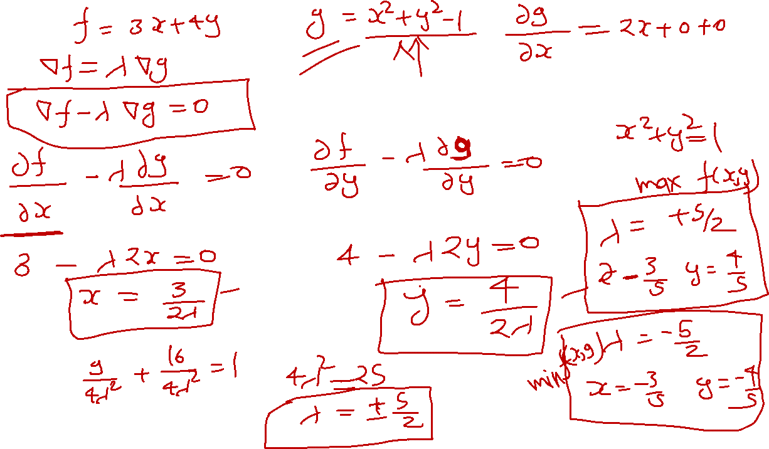

Slide 29
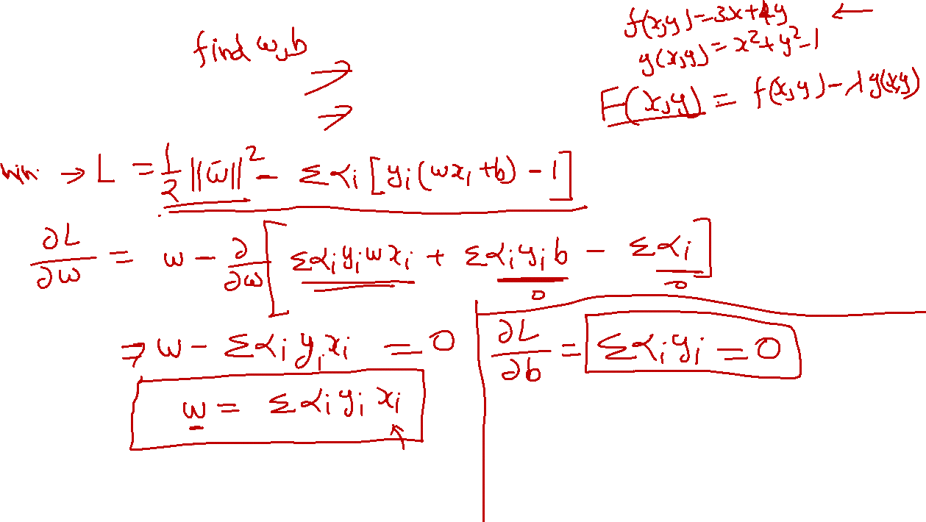

Slide 30
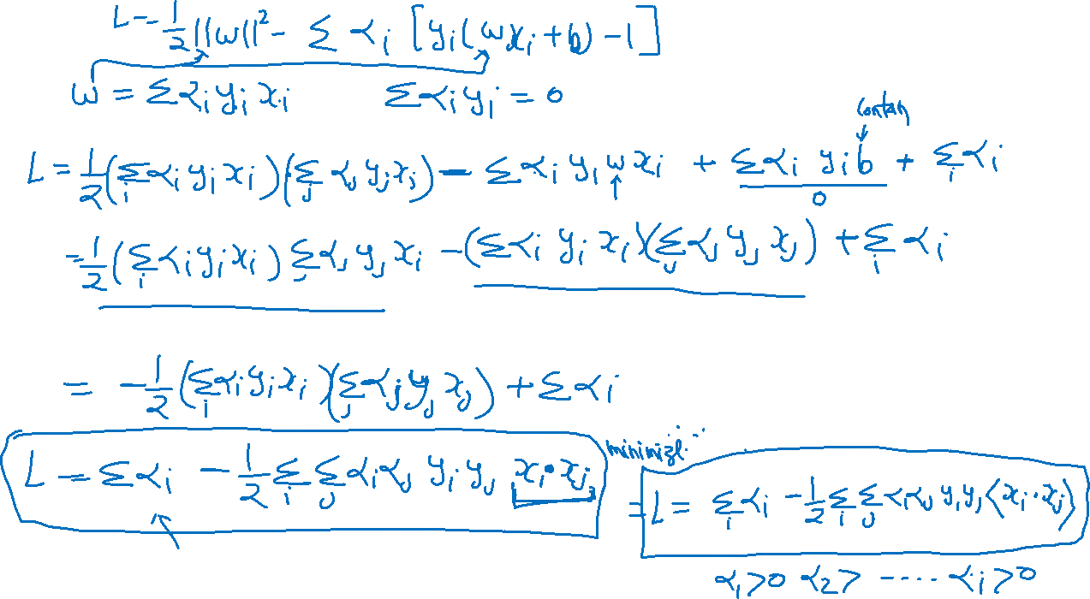

Slide 31
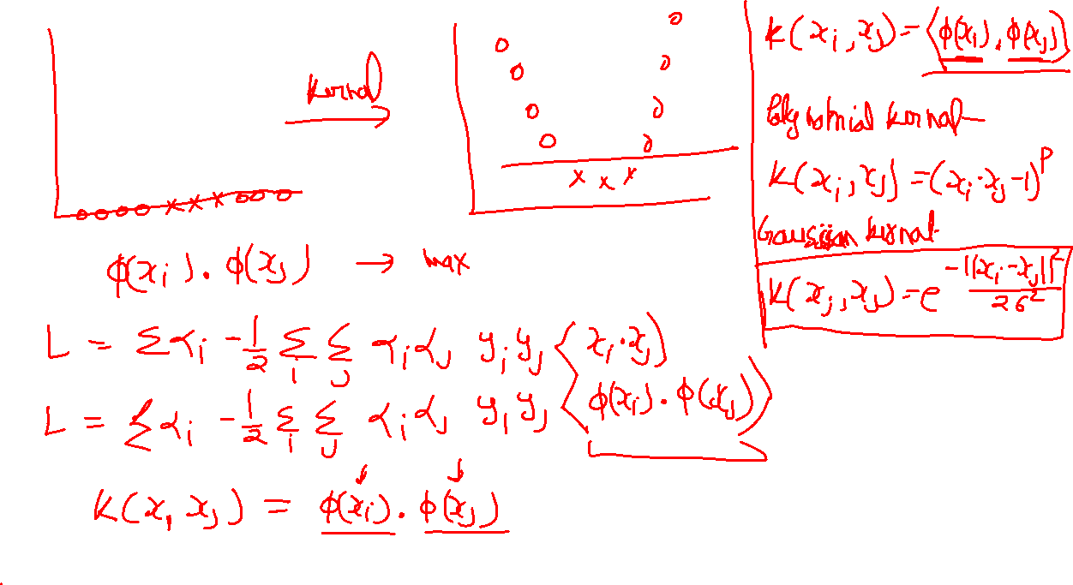
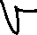
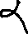
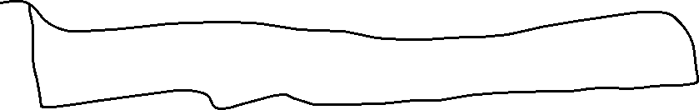
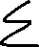

Slide 32
